Slide 1
Asynchronous Circuit Verification: from Specification to Circuit
Thang H. Bui
CSE@HCMUT

Slide 2
Abstract
Electronic Design Automation (EDA) tools have been considered long time ago in hardware design. Some tools have also been proposed for asynchronous circuits, an emerged approach to overcome the clock distribution problem, the main drawback of synchronous circuits. However, there are only a few EDA tools as well as methods for designing and verifying the correctness of the produced circuits. In general, they are lack of supportive environments for designing, verifying and synthesizing circuits. This work is about a method in applying formal verification to asynchronous circuit design. The new version of the PAiD tool developed at HCMC University of Technology that can enable engineers to design, verify and synthesize asynchronous circuits will also be discussed.

Slide 3
Agenda
Asynchronous circuit design
Proposed verification approach
On-going work
Discussion

Slide 4
Asynchronous circuit design

Slide 5
Why Asynchronous Circuit?
Synchronous Circuit Drawbacks
  Clock skew
  Jitter
  High power consumption
Asynchronous Circuit
  No clock distribution
  Handshake protocol
  → Promising Replacement

Slide 6
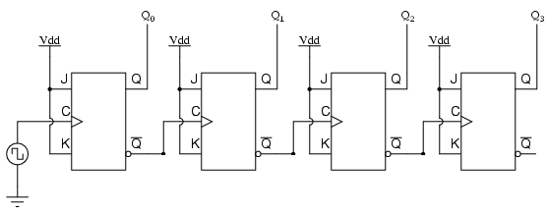
Why Asynchronous Circuit?
NO clock
Local synchronization
Mid 1950s
A four-bit Asynchronous up counter

Slide 7
Asynchronous Circuits Design Tools
EDA tool
  Tangram^{[1]}
  Theseus Logic^{[2]}
  PAiD^{[3]}
[1] H. van Gageldonk, K. van Berkel, A. Peeters, D. Baumann, D. Gloor, and G. Stegmann. An synchronous low-power 80C51 Microcontroller. In Proceedings of the International Symposium on Advanced Research in Asynchronous Circuits and Systems, Apr. 1998.
[2] M. Ligthart, K. Fant, R. Smith, A. Taubin, and A. Kondratyev. Asynchronous design using commercial HDL synthesis tools. In Proceedings of the International Symposium on Advanced Research in synchronous Circuits and Systems, pages 114–125. IEEE Computer Society Press, Apr. 2000.
[3] A-V. Dinh-Duc, “PAiD – A Novel Framework for Design and Simulation of Asynchronous Circuits”, Journal of Science and Technology Development, Vol. 14, No. K2, 2011, ISSN 1859-0128, pp. 37-45.

Slide 8
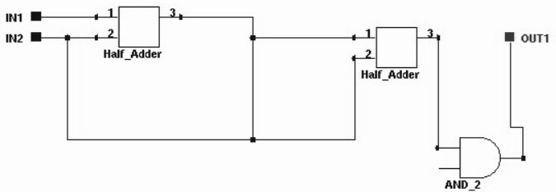
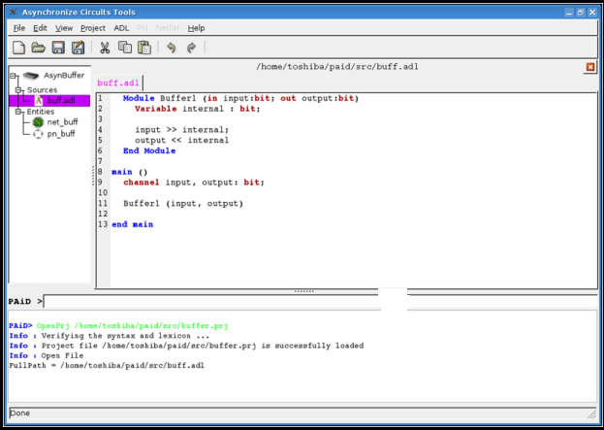
Asynchronous Circuit Design Challenges
Circuit design common problems
  Behavior Description language
  Synthesis
  Verification
Electronic Design Automation – EDA
Netslist
Description
Synthesis

Slide 9
Asynchronous Circuit Design Challenges
Asynchronous circuit?
  Common problems (description language, synthesis, verification)
  Handshake protocol (synchronization timing)

Slide 10
Past Researches on Asynchronous Circuits
ADL (Asynchronous Description Language) [1]
Simulation [2]
Representation [3]
Placement and Routing [4]
Technology mapping [5]
A.V. Dinh-Duc et al., 2005
L. Nguyen-Thanh, K. P. Phan, and A.V. Dinh-Duc – Behavior-Level Simulation of Asynchronous Circuits. Proc. Int. Workshop on Advanced Computing and Applications (ACOMP), 2007, pp. 80-85.
H. H. Tran, T. L. Ho, and A.V. Dinh-Duc – PETRI-DFG – an intermediate representation of asynchronous circuits. Proc. 10th Conf. on Science and Technology, Vietnam, 2007.
Q. C. Pham, T. N. Nguyen-Vu, A.V. Dinh-Duc, and H. A. Pham – Placement and Routing Algorithms for Asynchronous Logic Circuits. Proc. Int. Workshop on Advanced Computing and Application (ACOMP), 2007, pp. 178-186.
T. H. Dam-Thi, V. H. Bui, and A. V. Dinh-Duc - Automatic Technology Mapping for Quasi Delay-Insensitive (QDI) Asynchronous Circuits. Proc. Int. Workshop on Advanced Computing and Applications (ACOMP), 2007, pp. 23-32.

Slide 11
Motivation
Verification on an existing design (& synthesis) tool
  At what level of circuit description?
  What are the main correctness concern at each level?
  What verification approach can be applied?
  How to interpret the verification result

Slide 12
Asynchronous circuit Verification

Slide 13
Research Problem
Past:
  Description language
  Synthesis for QDI (Quasi-Delay Insensitive) circuit
Current:
  At Immediate-level of description (using PN-DFG)
  Behavior correctness
  Using NuSMV model checking tool
On-going & future:
  Formal specification for asynchronous circuits
  Automatic verification and synthesis
  Design environment (EDA) tool

Slide 14
Applications of Formal Verification to Asyn. circuits
Theorem proving
  Concrete mathematic foundations
Model checking
  Computer diligence

Slide 15
Applications of Formal Verification to Asyn. circuits
Theorem proving example:
  Gordon:
    Higher-order logic
    Successful verifying an n-bit full adder.
  Boyer et al.:
    N-node delay-insensitive asynchronous FIFO
    Safety and liveness properties.
M. Gordon - Why higher-order logic is a good formalism for specifying and verifying hardware, Formal Aspects of VLSI Design, Holland, 1985, pp. 153-177.
R. S. Boyer, M. Kaufmann, and J. S. Moore – The Boyer-Moore theorem prover and its interactive enhancement. Computers & Mathematics with App. 29(2), 1995, pp. 27-62.

Slide 16
Applications of Formal Verification to Asyn. circuits
Model checking example:
  Clarke, Emerson, Queille and J. Sifakis
    Asynchronous arbiter
  Attacking state explosion problem
    Symbolic representation
    Partial order reduction
    Abstraction
    Composition
A. Cimatti, E. M. Clarke, F. Giunchiglia, and M. Roveri - NUSMV: A New Symbolic Model Verifier. CAV'1999, pp.495-499.
D. L. Dill, and E. M. Clarke - Automatic Verification of Asynchronous Circuits Using Temporal Logic, Michael Yoeli (Ed.), Formal Verification of Hardware Designs, IEEE CS, 1991, pp. 176-182.
E. M. Clarke, and J. M. Wing - Formal methods: state of the art and future directions, ACM Comput. Surv. 28 (4), 1996, pp. 626-643.
Queille, J. P.; Sifakis, J. (1982), Specification and verification of concurrent systems in CEASAR, International Symposium on Programming
Edmund M. Clarke, E. Allen Emerson: "Design and Synthesis of Synchronization Skeletons Using Branching-Time Temporal Logic". Logic of Programs 1981: 52-71.

Slide 17
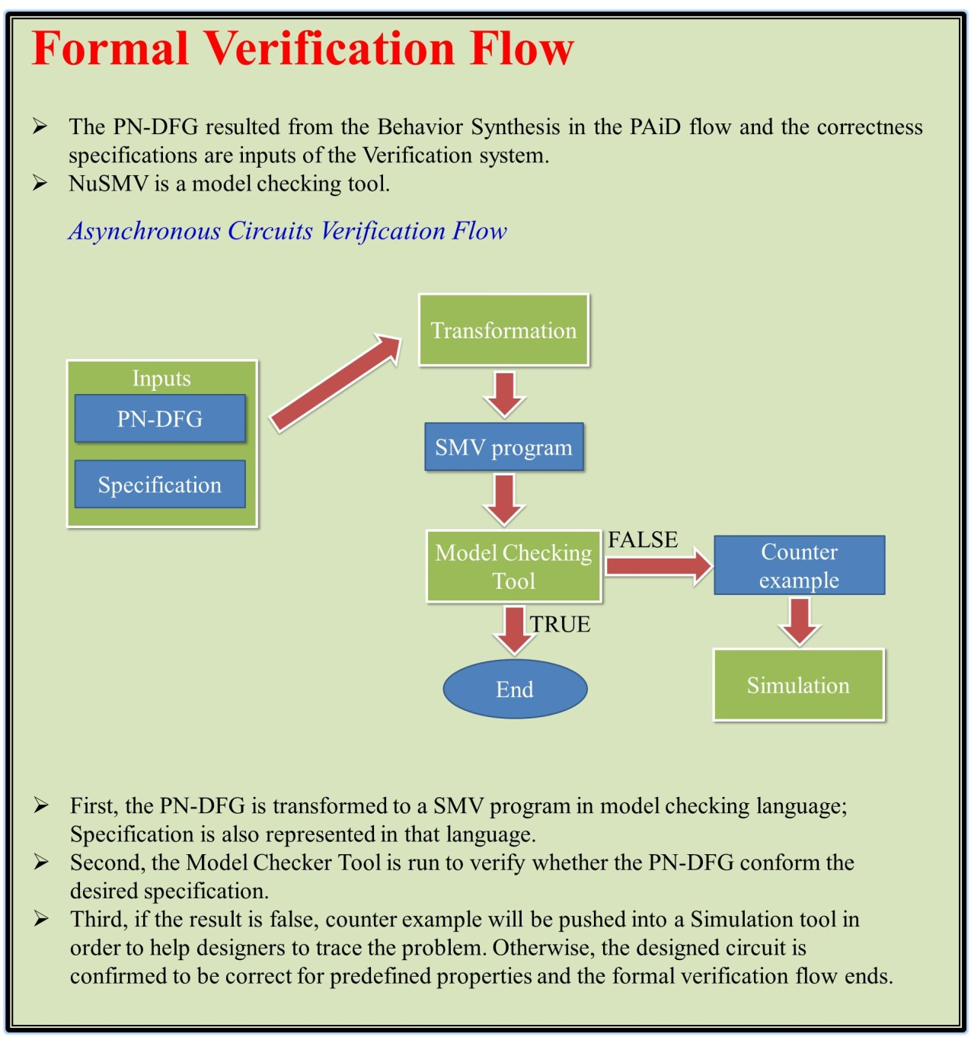
Our Approach

Slide 18
(1) PN-DFG to NuSMV
Register Transfer Level
PN-DFG
Specification
Transformation
NuSMV
NuSMV Program

Slide 19
(2) Support (more) Formal Specification in ADL
Asynchronous Description Language
Asynchronous Description Language
Formal Specification
PN-DFG
Transformation
New Compiler
NuSMV Program
NuSMV Program

Slide 20
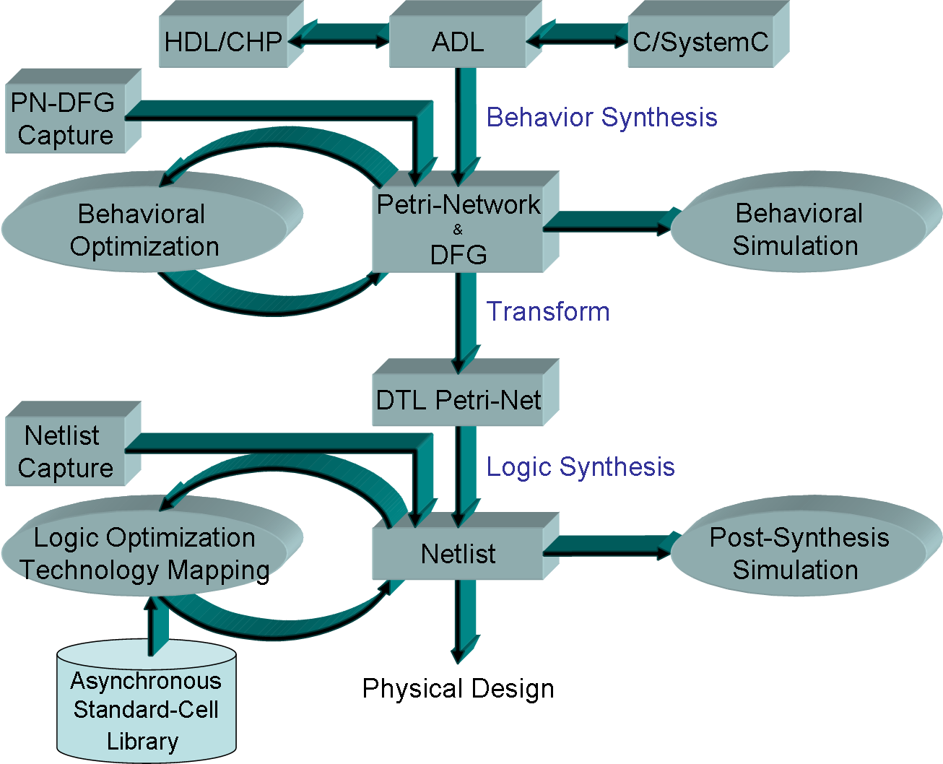
PAiD general architecture
Verification

Slide 21
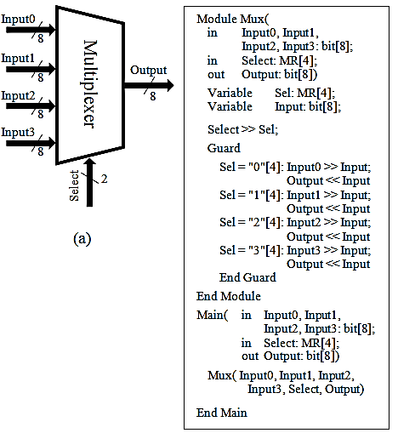
A Case-Study
A multiplexer in ADL
  High abstraction level
  Concurrent processes
  Communication channels

Slide 22
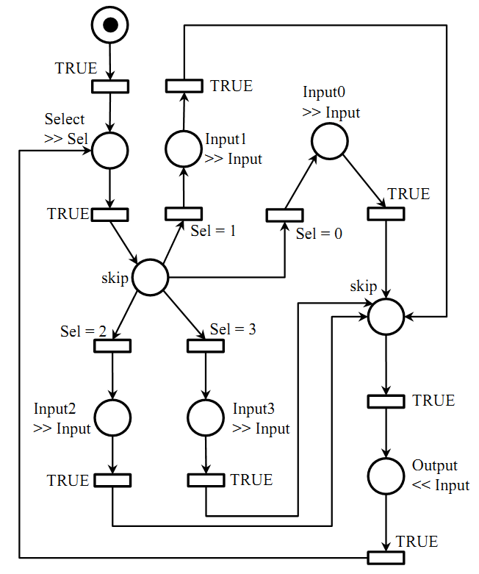
A Case-Study
PN-DFG
  Smaller than that of PN
  Free of environment
Petri nets
Representing Control flow
PN-DFG Model
Data Flow Graph
Representing Data flow
PN-DFG model for the Multiplexer

Slide 23
A Case-Study
PN-DFG to NuSMV
PN-DFG
NuSMV
Place
  Having token status
  Initial marking
Transition’s enable status
Transition’s firing action
Variable
  Keyword: VAR
  Variable’s value
  Keyword: INIT
Conditional expression
  Keyword: DEFINE
NuSMV’s transition
  Keyword: TRANS

Slide 24
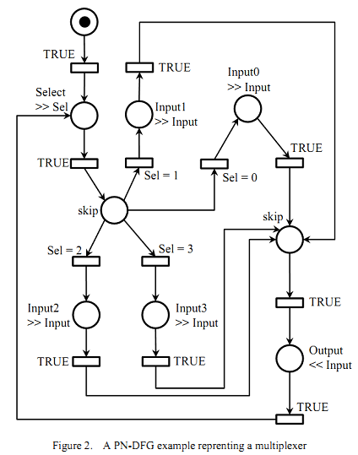
A Case-Study
NuSMV description
NuSMV
VAR
P: array 0..8 of Boolean
INIT
P[0] = true &
P[1] = false & P[2] = false
& … & P[8] = false

Slide 25
A Case-Study
NuSMV description
NuSMV
DEFINE
T_en := P[1] & !P[2]
& (Sel = 2)
TRANS
…
| T_en &
next(P[1]) = ![P1]
& next(P[2]) = ![P2]
& next(P[others]) = P[others]
& next(Input) = Input2
| …
P1
T
P2

Slide 26
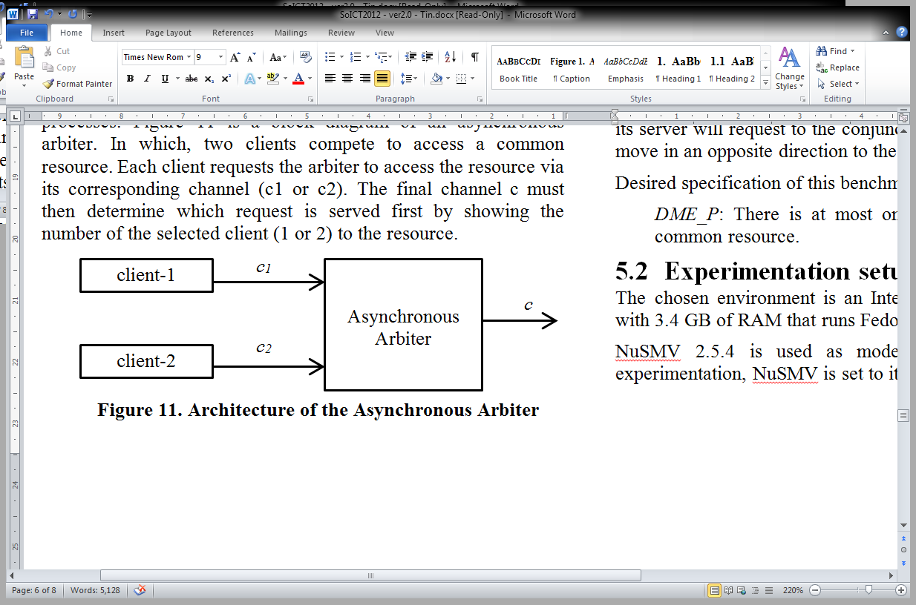
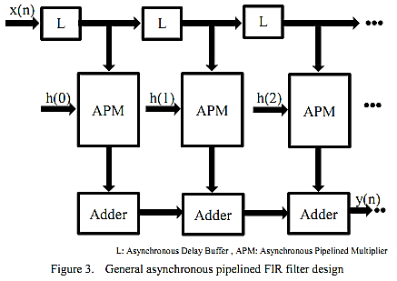
Some Verified Circuits
Asynchronous arbiter:
  AG (c1_request -> AF (c=1))
Asynchronous Pipelined FIR Filter:
  AG (x=1
  -> AF (A[L0=1 U L1 = 1]))
L0
L1
General Asynchronous Pipelined FIR Filter Design

Slide 27
On-Going Work

Slide 28
Formal Description To Circuit Description Language
Pre-/Post-condition
Invariance (if any)
Purpose

Slide 29
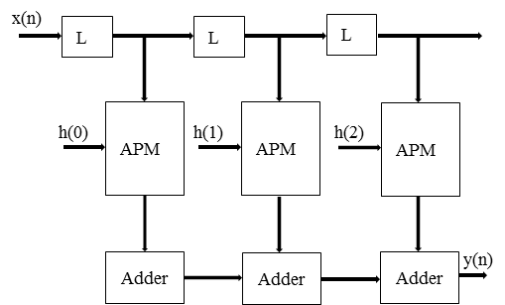
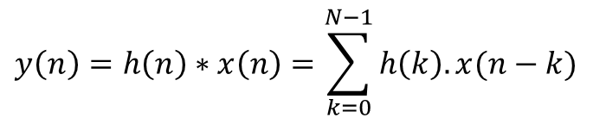
Formal Description To Circuit Description Language
Example: FIR filter
$$y\left(n\right)=h\left(n\right)∗x\left(n\right)=\sum_{k=0}^{N−1}{h\left(k\right). x(n−k)}$$

Slide 30
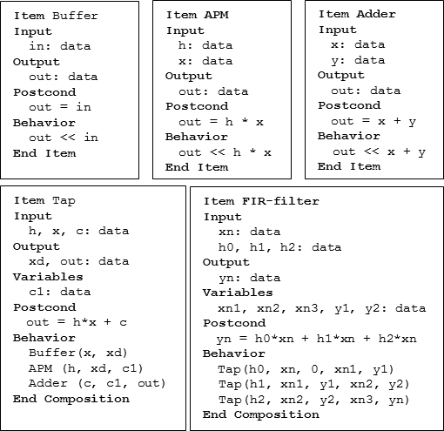
Formal Description To Circuit Description Language
Example: FIR filter

Slide 31
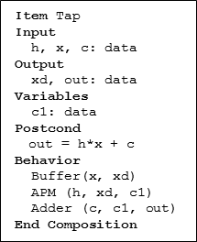
Formal Description To Circuit Description Language
Example: FIR filter
postcond(Tap) ⊆
(precond(Tap) ∪ postcond(Buffer) ∪ postcond(APM)
∪ postcond(Adder))

Slide 32
Formal Description To Circuit Description Language
Example: FIR filter
postcond(Tap) ⊆
(precond(Tap) ∪ postcond(Buffer) ∪ postcond(APM)
∪ postcond(Adder))
Verify circuit as you design
Automatic design a circuit upon a requirement?

Slide 33
discussion

Slide 34
Current Work
Up:
  PAiD environment for designing, synthesizing and verifying asynchronous circuits
Down:
  Verify small-size asynchronous circuits
  Time/Resource consuming in verification

Slide 35
On-Going & Future Work
Automatic design upon request
Circuit optimization
Lower-level verification

Slide 36
Thanks!

Slide 37
Appendix: PN-DFG to NuSMV

Slide 38
PN-DFG to NuSMV
Transformation rules:
  (i): Places are described as boolean variables Pi’s
  (ii): Initial marking is the initial value of Pi’s
  (iii): Enable status of transitions are defined such as it is enabled iff it is enable in the corresponding Petri net and the attached guard DFG is satisfied.
  (iv): Transitions are represented as non-deterministic NuSMV transitions. When a transition fires, the tokens in all of its input/output places are toggled, the other places are remained still, and the DFG that attached to its output places are all executed.
  (v): System properties are expressed in CTL or LTL by using the SPEC or LTLSPEC keywords.

Slide 39
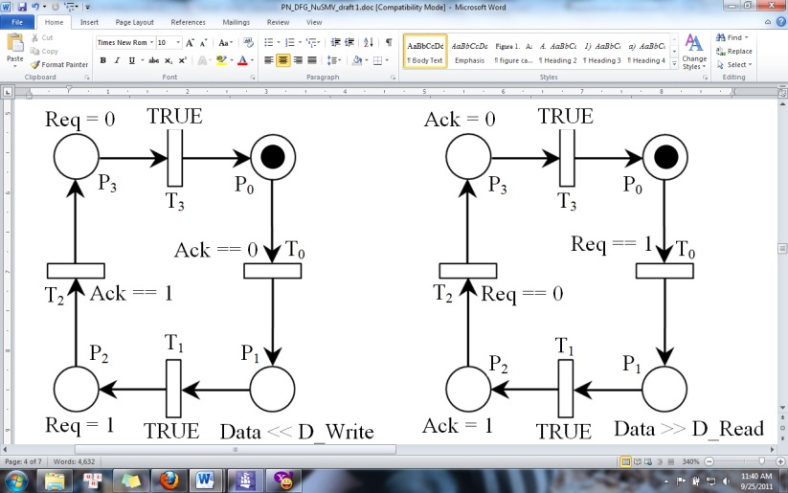
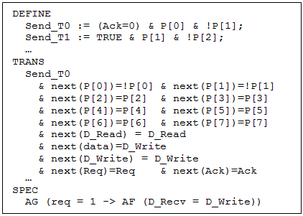
PN-DFG to NuSMV

Slide 40
PN-DFG to NuSMV
 | System-as-a-whole | System-as-components
No marking encoding | - Name: A1 - Cons: Complex updating places + Complex + No-reuse | - Name: B1 - Pros: Understandable, re-usable - Cons: Complex updating places + Variable synchronization
Marking encoding | - Name: A2 - Pros: Efficient updating places - Cons: Complex + No-reuse | - Name: B2 - Pros: Efficient updating places + Understandable, re-usable - Cons: Variable synchronization

Slide 41
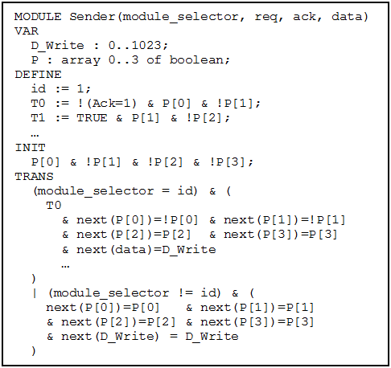
PN-DFG to NuSMV

Slide 42
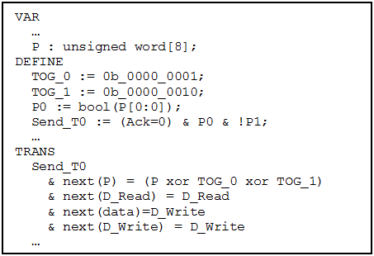
PN-DFG to NuSMV

Slide 43
PN-DFG to NuSMV
 | System-as-a-whole | System-as-components
No marking encoding | - Name: A1 - Cons: Complex updating places + Complex + No-reuse | - Name: B1 - Pros: Understandable, re-usable - Cons: Complex updating places + Variable synchronization
Marking encoding | - Name: A2 - Pros: Efficient updating places - Cons: Complex + No-reuse | - Name: B2 - Pros: Efficient updating places + Understandable, re-usable - Cons: Variable synchronization
The best: No-marking-encoding system-as-components (B1)

