Slide 1
AndroidCompiler

Slide 2
Layout
Motivation
Literature Review
AndroidCompiler
Future Works

Slide 3
Movtivation
Android is becoming increasingly popular now
Many applications deal with sensitive data such as contact number, sms messages, .. .
→ the security of Android applications is receiving many increasing attentions
→ we need to find a way to verify Android applications
Android application → Android Compiler → target Model (we verify on this model)

Slide 4
Layout
Motivation
Literature Review
AndroidCompiler
Future Works

Slide 5
Literature Review
Malware-Code Detection for Android
Contextual Policy Enforcement in Android Applications with Permission Event Graphs (2012)
Formal Modeling and Reasoning about the Android Security Framework (2012)
Model-Checking for Verifying Android:
Using Monterey Phoenix to Formalize and Verify System Architectures (2012 –NUS )

Slide 6
Contextual Policy Enforcement in Android Applications with Permission Event Graphs
focus on detecting malicious behavior that can be characterized by the temporal order in which an application uses APIs and permissions
Example:
a malicious audio application: recording audio after the stop-button pressed
a normal audio application: stop recording when user pressed stop-button
→ 2 applications use the same permissions, APIs

Slide 7
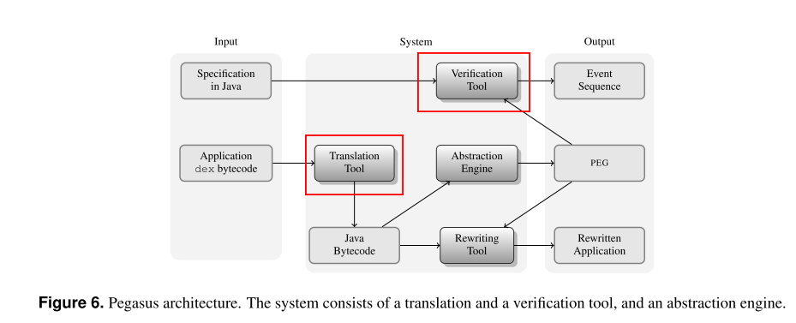
Contextual Policy Enforcement in Android Applications with Permission Event Graphs

Slide 8
Contextual Policy Enforcement in Android Applications with Permission Event Graphs
Pegasus tool:
11626 lines of code
PEG: Permission Event Graph
Event Sequence: a counter example
Rewirting Tool: to include runtime checks cases static analysis does not succeed

Slide 9
Contextual Policy Enforcement in Android Applications with Permission Event Graphs
Pegasus tool:
Abstraction Engine: constructing PEGs from Android applications.
Translation Tool : use Soot (A JAVA BYTECODE OPTIMIZATION FRAMEWORK)
Verification Tool: a veriﬁcation algorithm to check security properties written as Java checkers

Slide 10
Contextual Policy Enforcement in Android Applications with Permission Event Graphs
Pegasus tool – Questions?
Write model-checker by themselves : strong enough?
Translation from Java byte code : is exactly enough?
How about illegal access to resources in Code? Could they detect?
Could they deal with dynamic permission-granting?

Slide 11
Formal Modeling and Reasoning about the Android Security Framework (2012)
propose a formal model of Android OS
allows one to formally state the high-level security goals
They believe that their framework can accurately describe most of the security-relevant aspects of the Android OS

Slide 12
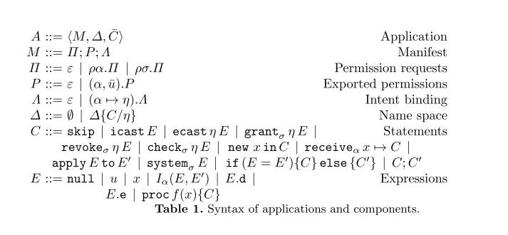
Formal Modeling and Reasoning about the Android Security Framework (2012)

Slide 13
Contextual Policy Enforcement in Android Applications with Permission Event Graphs
Questions?
Is their model totally correct?
→ we are trying to implement their model.

Slide 14
Using Monterey Phoenix to Formalize and Verify System Architectures (2012 –NUS )
NUS paper (2012)
Monterey Phoenix (MP): an architecture description language
can model system and environment behaviors based on event traces → good to model Android Application
A model checker for MP developed based on PAT
Safety property: check if nothing bad happened: deadock-freeness, reaching
Liveness property: check if something good eventually happend

Slide 15
Using Monterey Phoenix to Formalize and Verify System Architectures (2012 –NUS )
Questions?
Apply MP-model-checker for Android verification?
Liveness property MP-model-checker can verify?

Slide 16
Layout
Movtivation
Literature Review
AndroidCompiler
Future Works

Slide 17
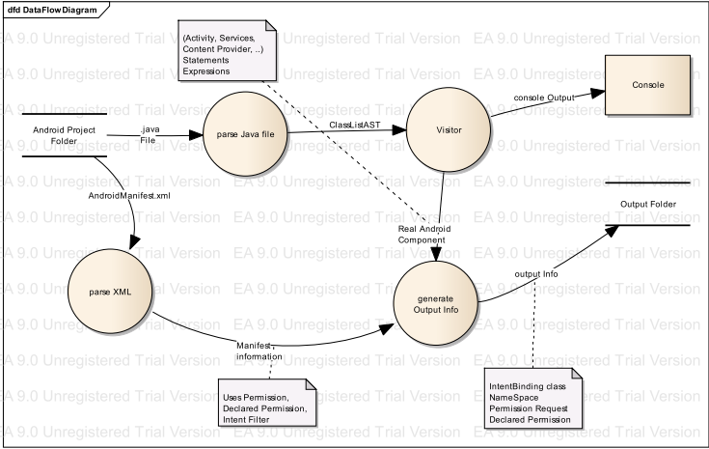
AndroidCompiler

Slide 18
AndroidCompiler
First goal is to use for Android programming subject at school
Student source-code -> parse: verify some property automatically, get statistic information: how students design for a specific problem, …
Test if the formal model in the paper “Formal Modeling and Reasoning about the Android Security Framework” correct or not

Slide 19
AndroidCompiler
Implementation:
Parse AndroidManifest.xml to get configuration information: permission request, declared request, intent-binding, event handler, ….
Parse *.java files to get Abstract Syntax Tree (AST)
Traverse on AST to generate target-language, target-model

Slide 20
Layout
Movtivation
Literature Review
AndroidCompiler
Future Works

Slide 21
FutureWorks
Add one more Compiler for bytecode -> target-Model
try to retrieve as much information from Java /bytecode as possible: dynamic permission-granting, accessing resources illegally in code, …
Applying model-checking to verify properties on target-Model
PAT (NUS): already support Monterey Phoenix (MP): easy to model Android application
Altarica (Labri-France): taught at PUF, similar to PAT
Altarica language , Dicky’s logic (extention of CTL), Altarica model-checker

